Slide 1






लोक शिकायत केंद्र, रांची
के वेब पोर्टल का उद्घाटन
ekuuh; eq[;ea=h, >kj[k.M
श्री हेमंत सोरेन
ds dj deyksa }kjk सम्पन।
29 दिसंबर 2021
क्लिक

Slide 2
Process Flow of Grievance & Compliance
मुख्यमंत्री जन संवाद केंद्र, झारखंड
District Nodal Officer
Department Nodal Officer
Departmental Subordinate at State, Divisional or Regional level (Eg.- JBVNL, CE, SE for Energy, etc.)
Sub-Department of merged Department. (i.e.- RWD of RD)
District Subordinate (Eg.- SDO, CO & BDO)
Departmental Subordinate at Block Level (Eg.- BEO/BSO)
Departmental Subordinate at District level. Eg.- EE of Energy or DSO of Food, Pub. Dist. & Consumer Affairs. Dept.

Slide 3
Features of Online system
Accessible from any where/any person for Grievance entry.
Complainant can also lodge their Grievance through Mobile Application.
Trace complain status by complainant only.
Compliance entry from Dist./Dept. Nodal Officers Desk.

Slide 4
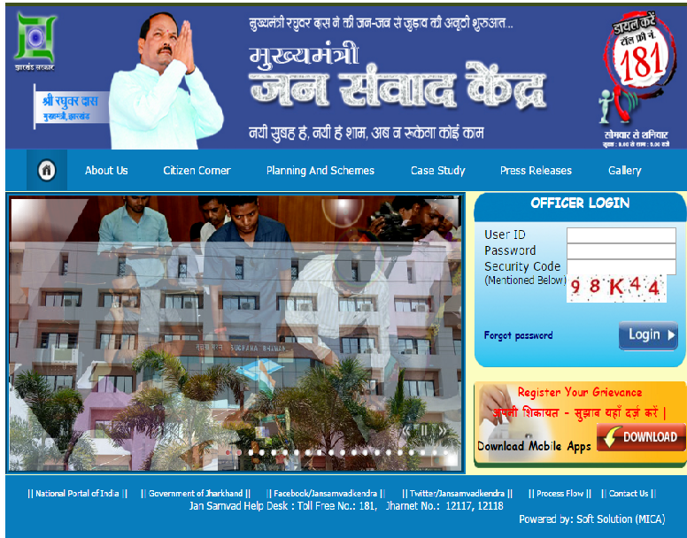
Website: jansamvad.jharkhand.gov.in

Slide 5
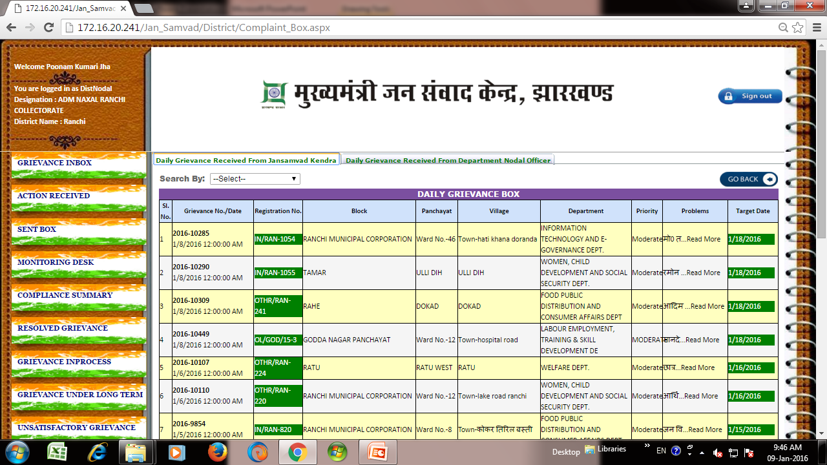
Grievance Inbox Panel of Collectorate

Slide 6
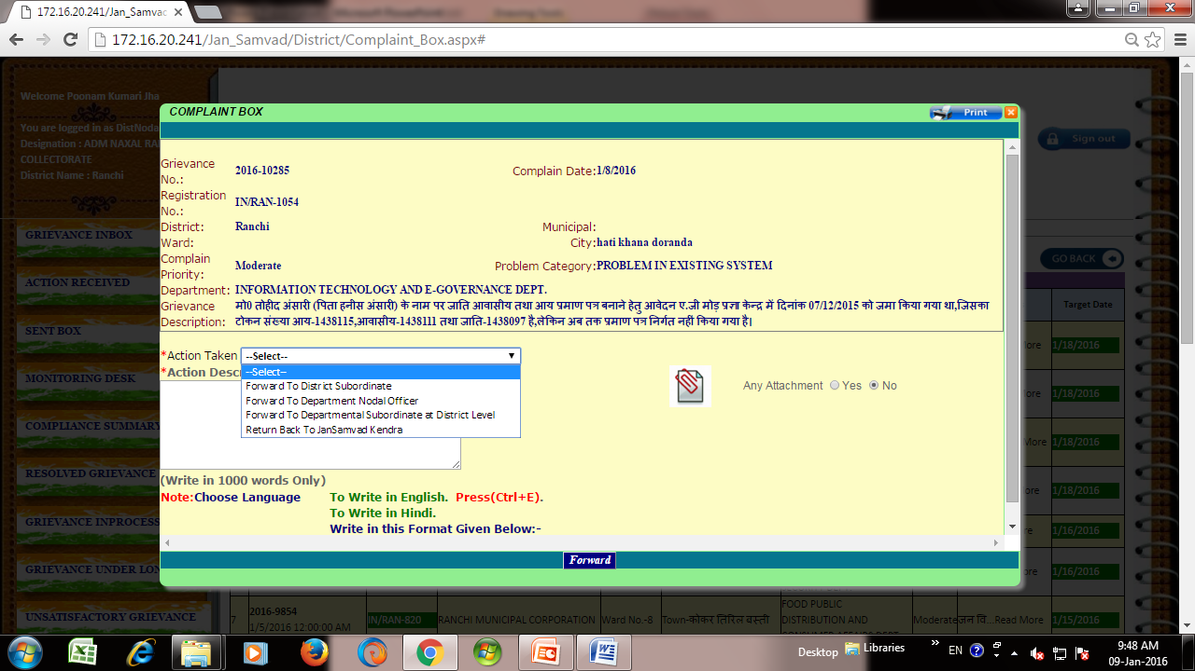
Collectorate Level Grievance Forwarding Panel

Slide 7
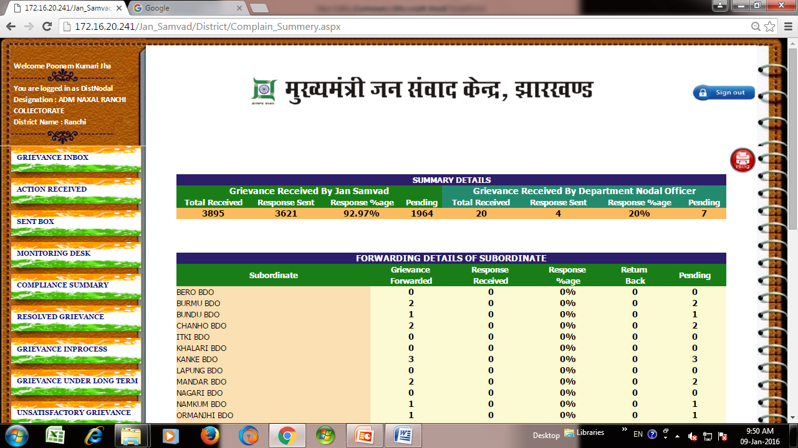
Collectorate Level Monitoring Desk

Slide 8
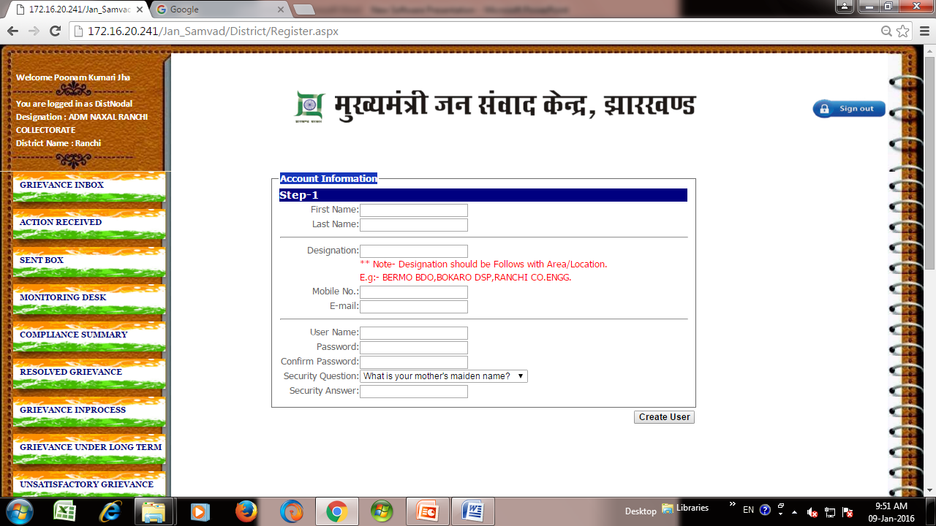
Collectorate Level Sobordinate Creation Menu

Slide 9

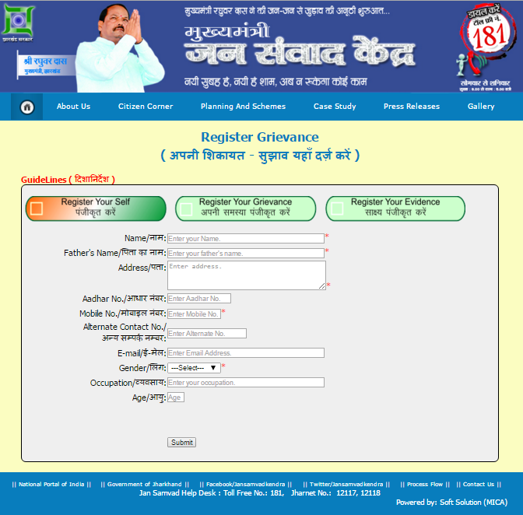
Grievance Lodging Portal For Citizens

Slide 10
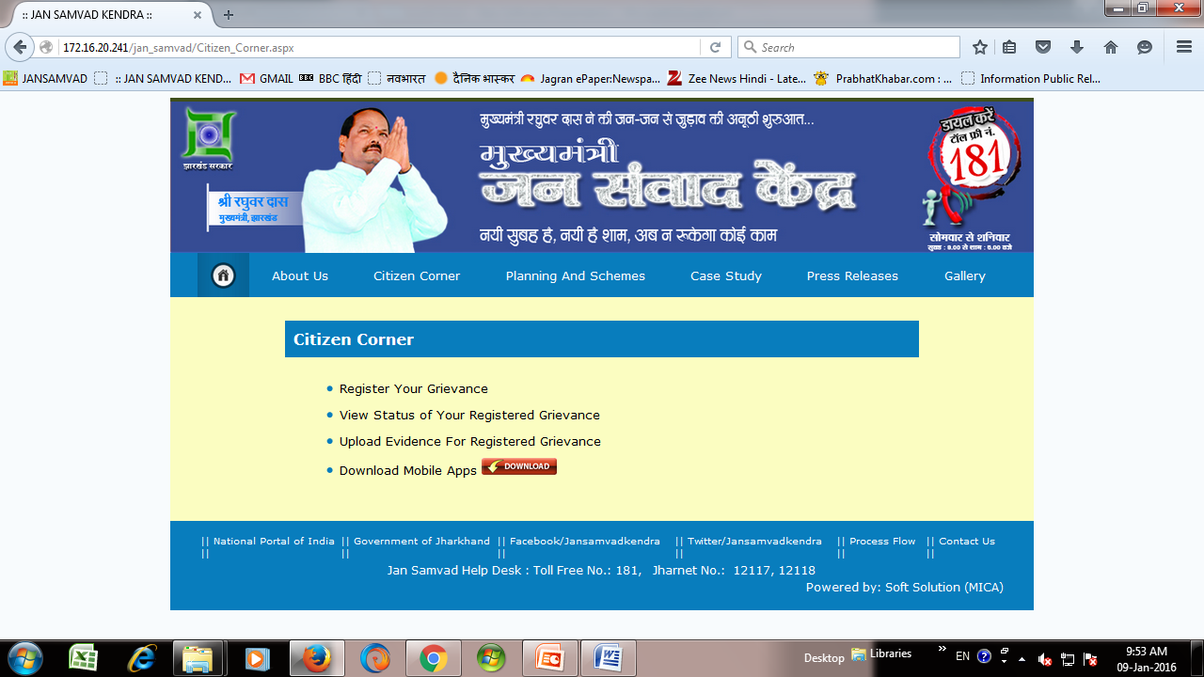
Citizen’s Portal

Slide 11
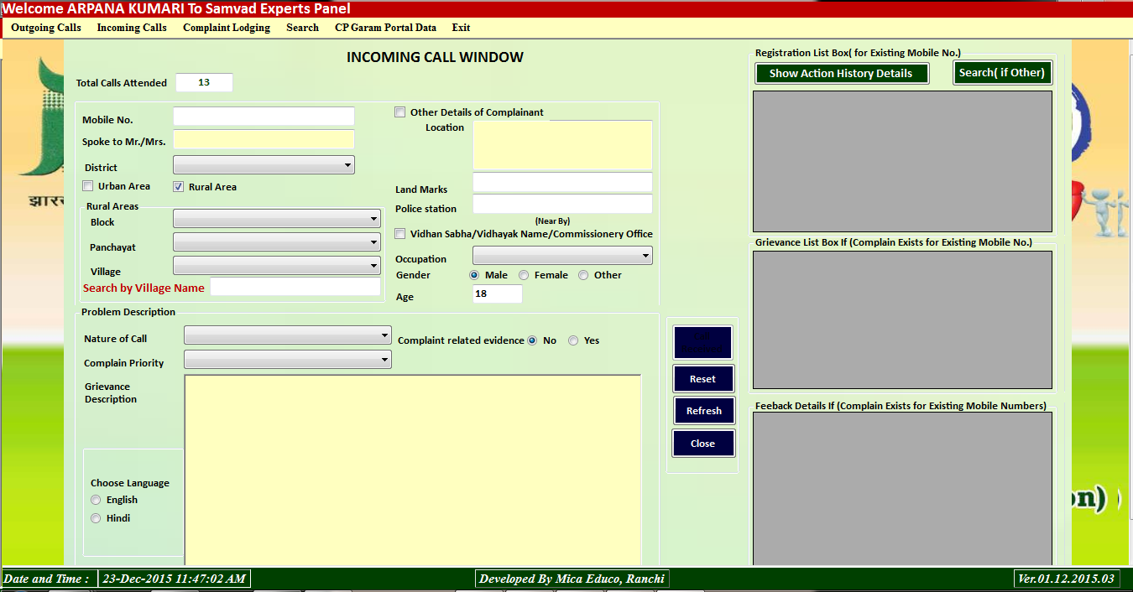
Incoming, Outgoing, Postal, CMO, Governor office & Social Media Grievance Lodging Portal

Slide 12
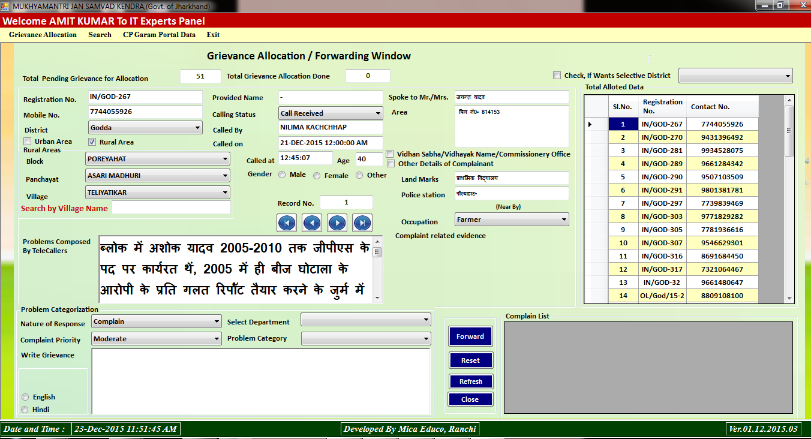
Grievance Allocation Panel at Jan Samvad

Slide 13
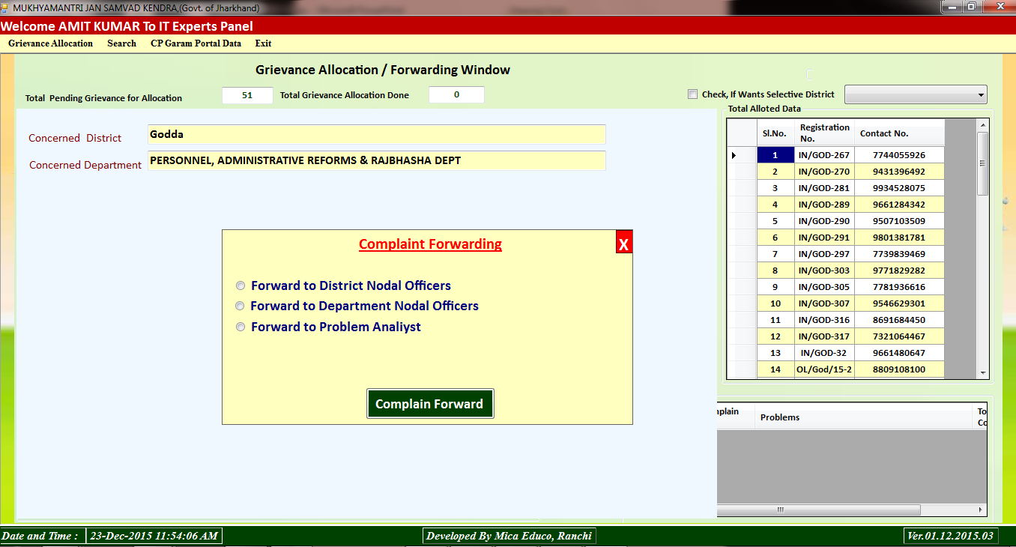
Grievance Allocation Panel-II

Slide 14
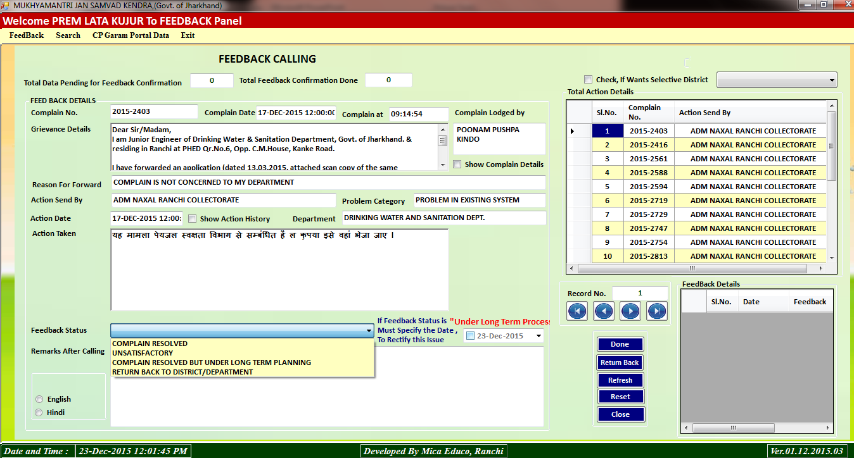
Compliance Coordinator Panel

Slide 15
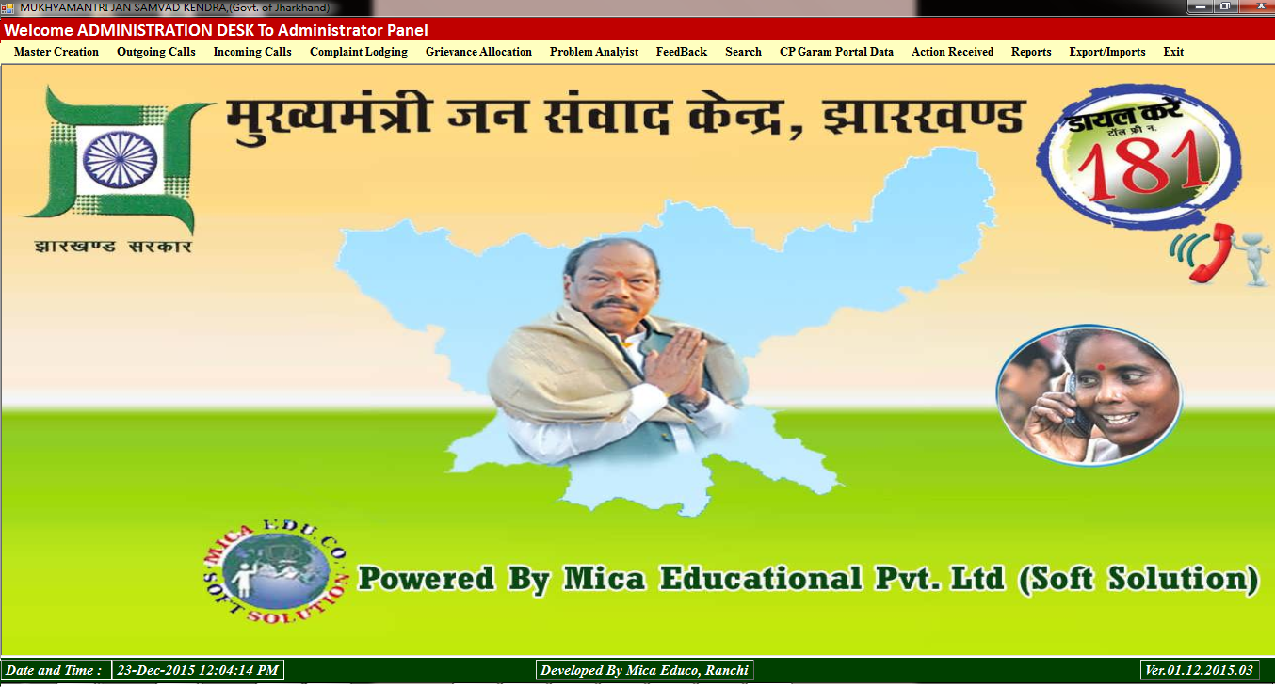
Administration Panel

Slide 16
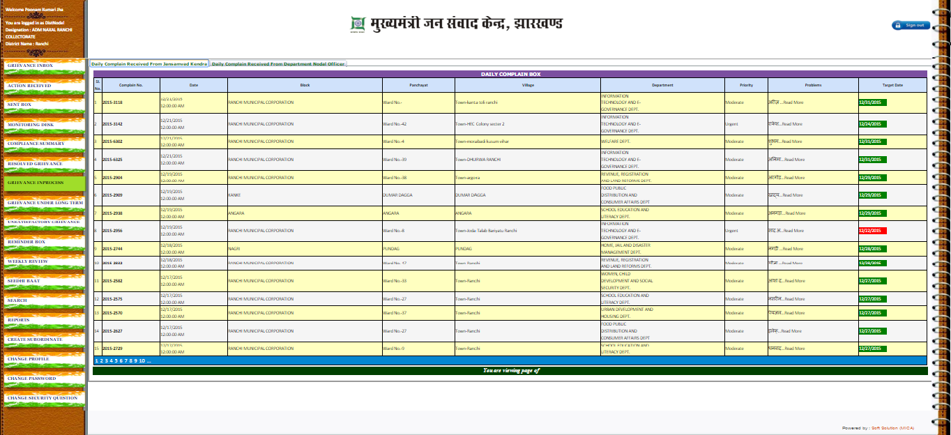
Welcome to Collectorate (Ranchi) Panel…

Slide 17
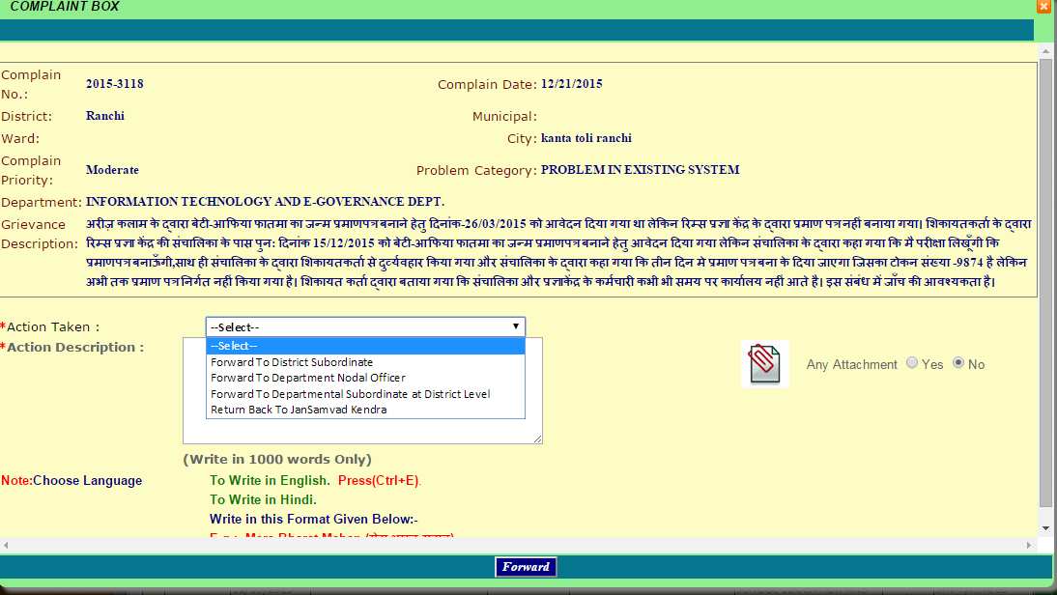
District Level Grievance Forwarding Panel

Slide 18
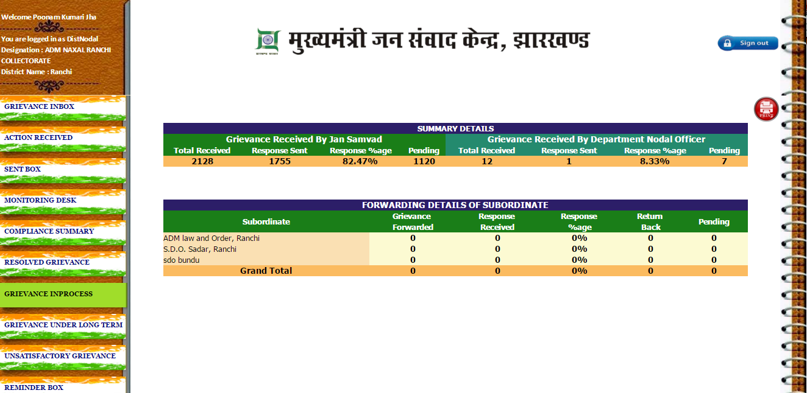
District Level Monitoring Desk

Slide 19
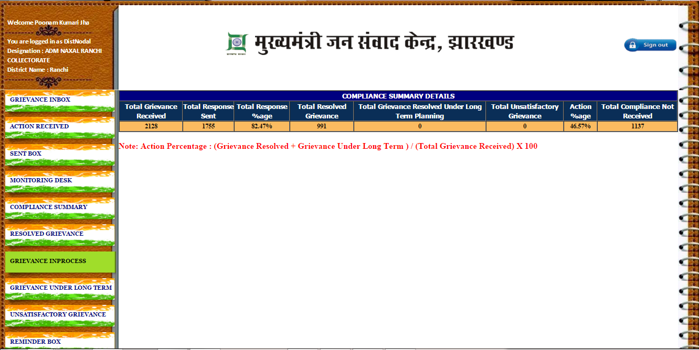
District Wise Compliance Summary

Slide 20
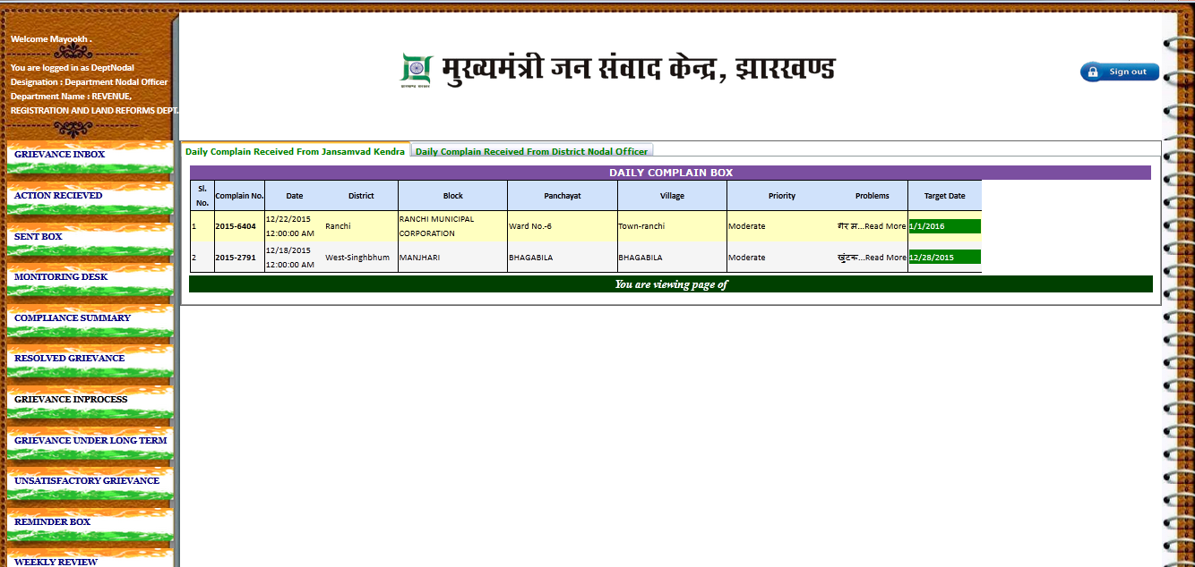
Department Panel

Slide 21
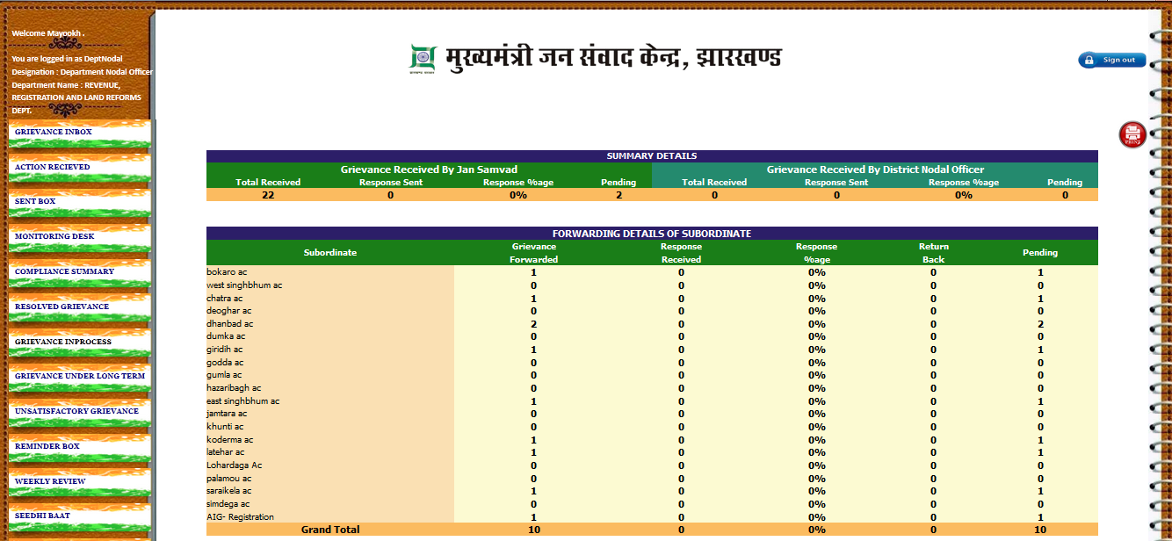
Department Monitoring Desk

Slide 22
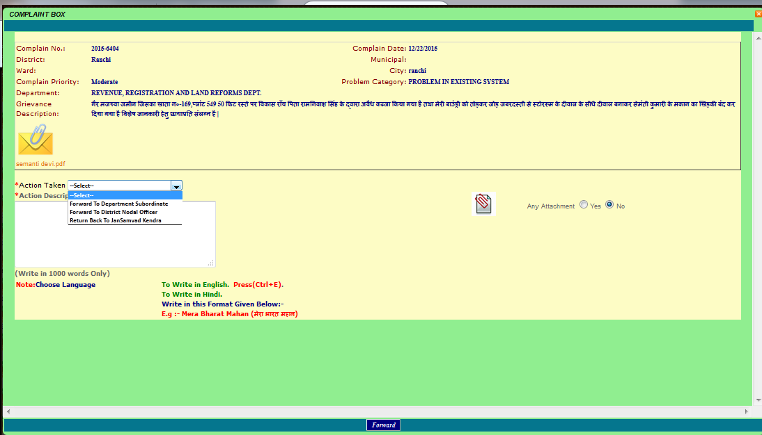
Department Level Grievance Forwarding Menu

Slide 23
Prepared By:
Jan Samvad IT Support Team
Thanks…

